Slide 1
12.06.2024
Principles of Autonomy and Decision Making
Student Name: Faris Hussain
Lecturer: Chidvilas Karpenahalli

Slide 2


Build and train Q-learning Agent
Custom environment of PADM student scenario.
Adapt the Q-learning agent.
Exploration.
Exploitation.
Q-table.
Notes:
MDPs are a theoretical framework for decision-making, assuming complete knowledge of the environment. They are used to define the problem.
Q-learning is an algorithm that solves the problem defined by MDPs without requiring full knowledge of the environment's dynamics. It learns by interacting with the environment and updating Q-values based on experiences.
Transition Model
MDPs: The transition model P(s′∣s,a)P(s'|s,a)P(s′∣s,a) is known and used to compute the expected value.
Q-learning: The transition model is not known. The algorithm estimates values based on observed transitions.

Slide 3
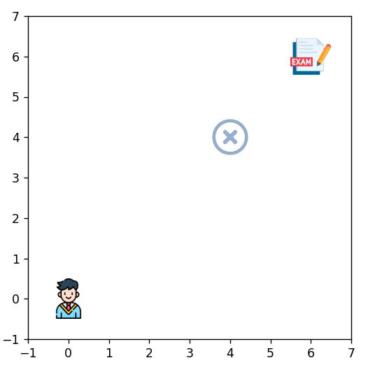
Environment
Student (Agent)
Exam (Goal)
De-Registration (Blocker)
Notes:
The agent is the student here like me.
The goal is the exam.
And huddle or blocker is the de-registration from the exam

Slide 4
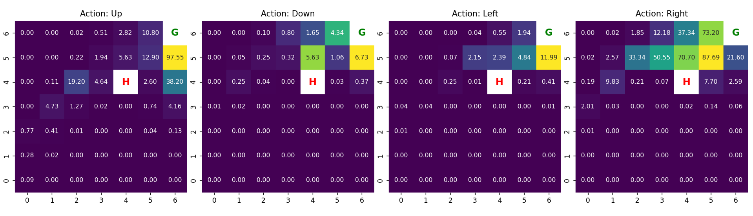
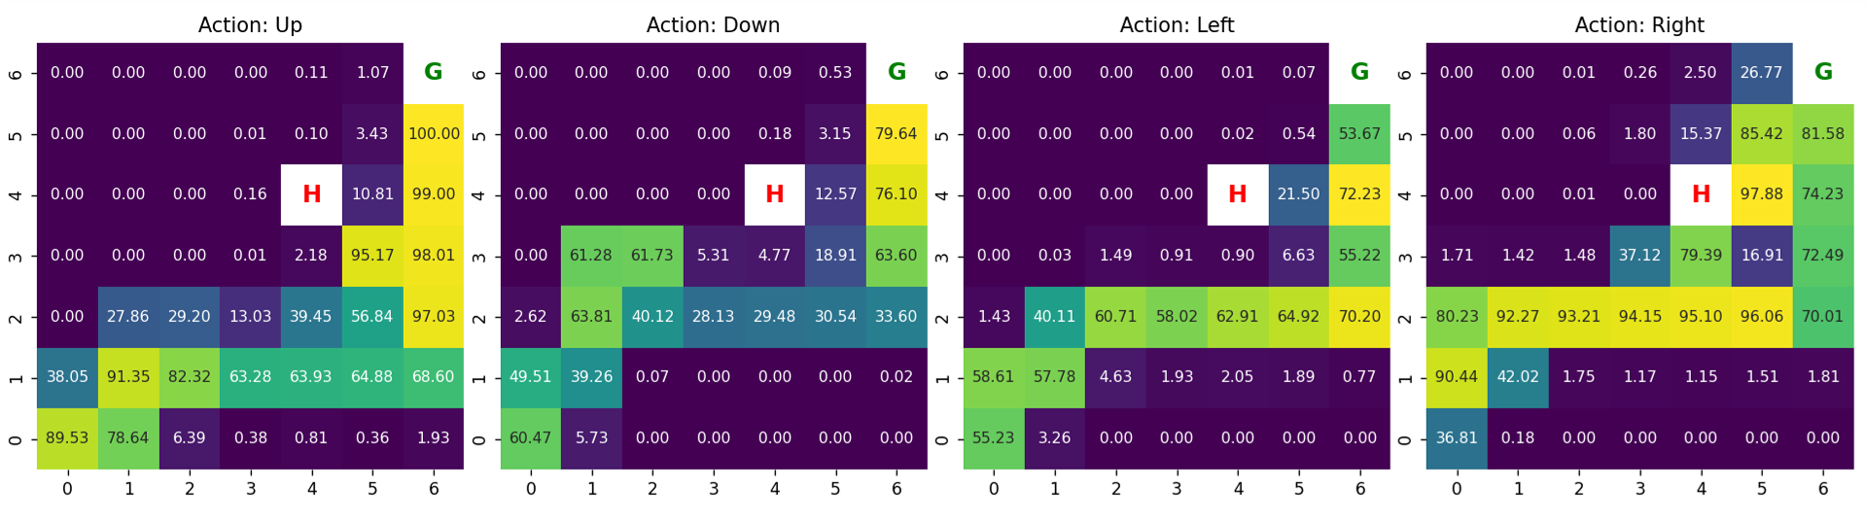
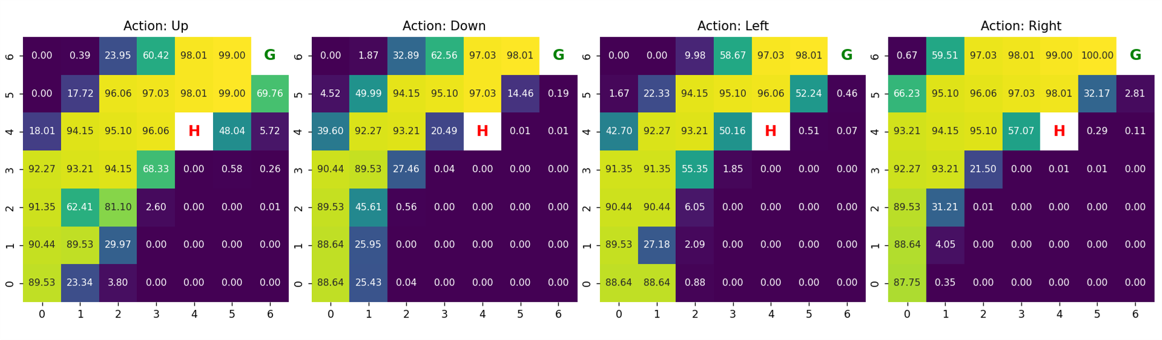
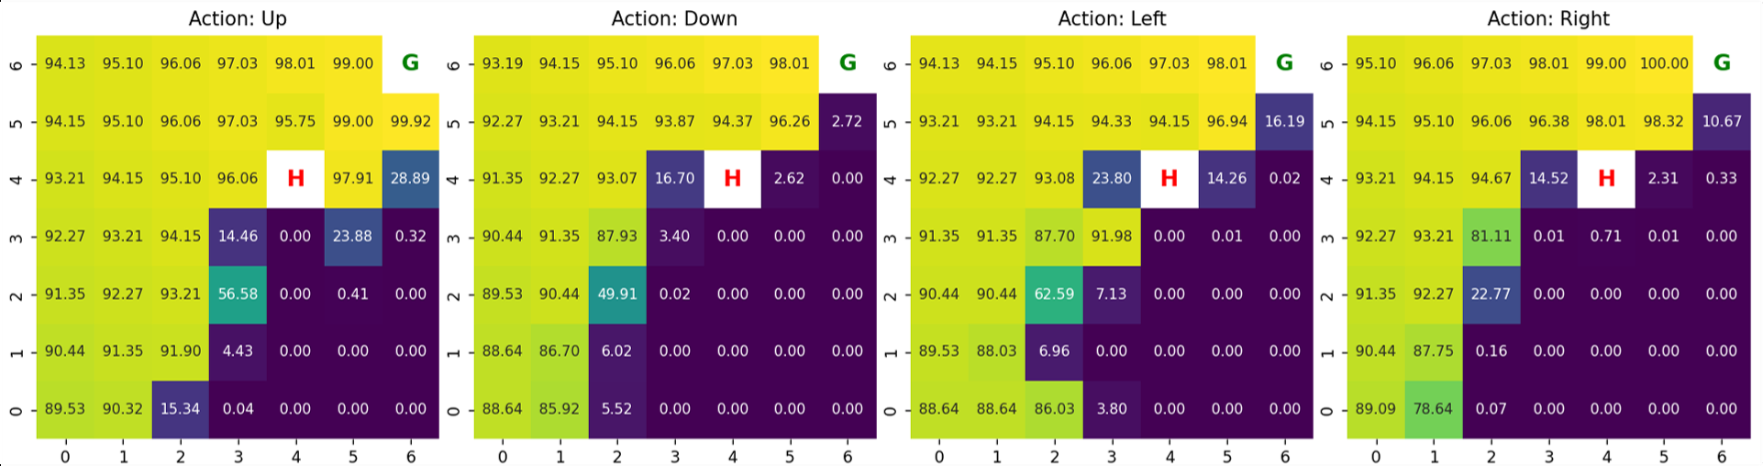
Case I: Episodes Changes
Goal Reward = 100 Blocker Reward = 0
Episode = 500
Episode = 5,000
Episode = 50,000
Episode = 500,000
Notes:
Keep the Goal Reward Constant = 100
Blocker Reward = 0
And keep changing Episode logarithmical.
To see on which episode my agent get learned

Slide 5
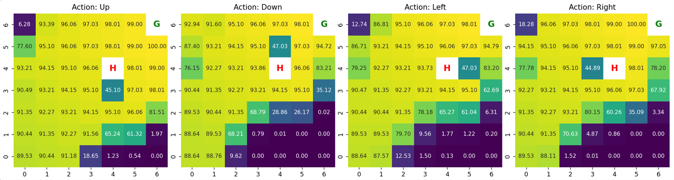
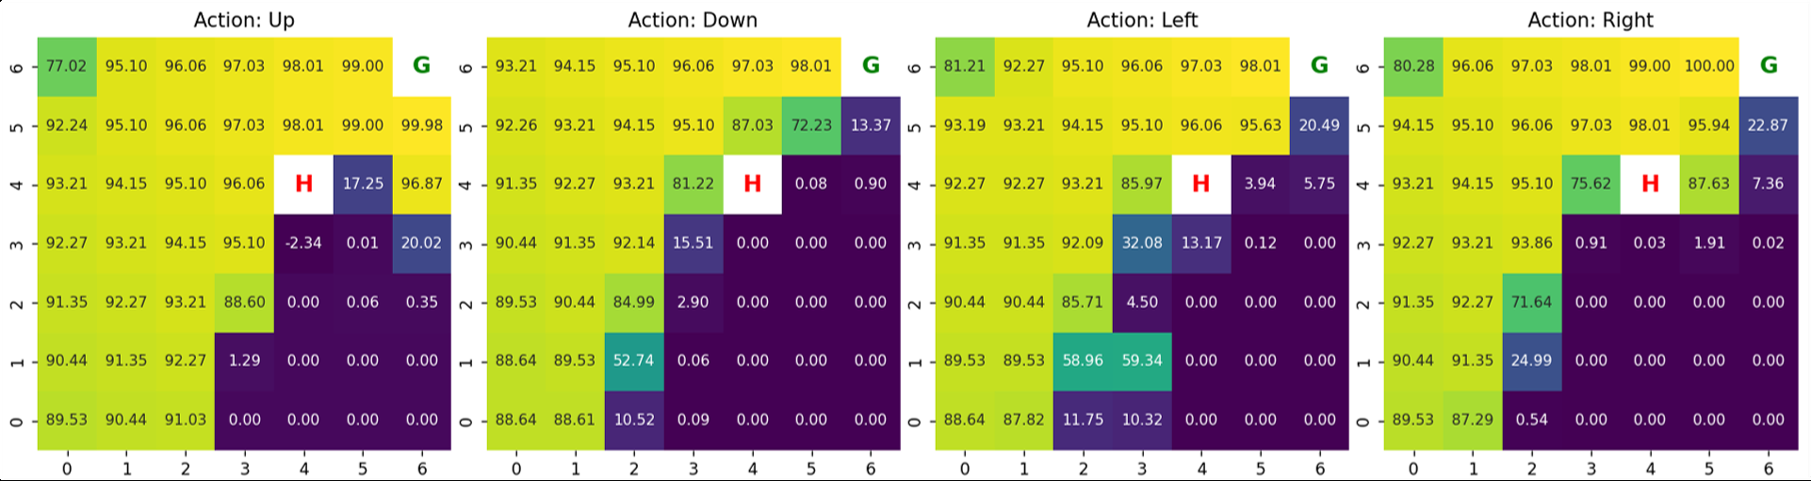
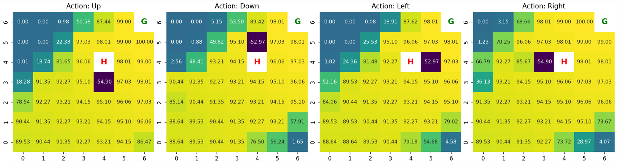
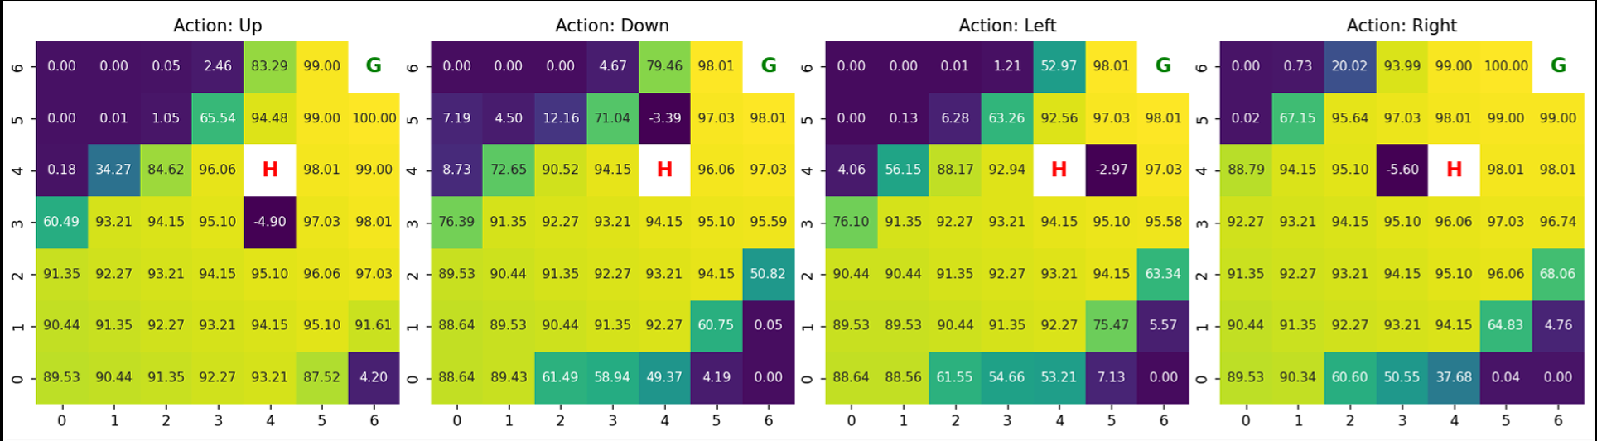
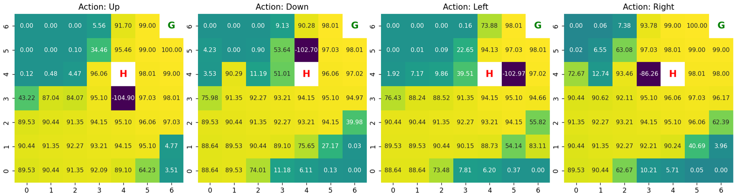
Case II: Blocker Changes
Goal Reward = 100 Episode = 500,000
Blocker Reward = 0
Blocker Reward = -10
Blocker Reward = -50
Blocker Reward = -150
Blocker Reward = -100
Blocker Reward = -200
Notes:
After Blocker set at -50 or more most of the grid I get the values.

Slide 6
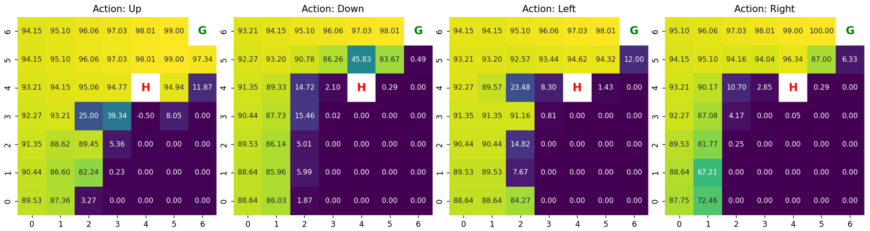
Case III: Epsilon Changes
Goal Reward = 100 Episode = 500,000
Blocker Reward = -50, Epsilon = 0.1
Blocker Reward = 0, Epsilon = 1
Blocker Reward = -10 , Epsilon = 1
Notes:
So changing epsilon from 1 to 0.1 for Blocker Reward = -50 make it similar to Blocker Reward 0 and -10

Slide 7
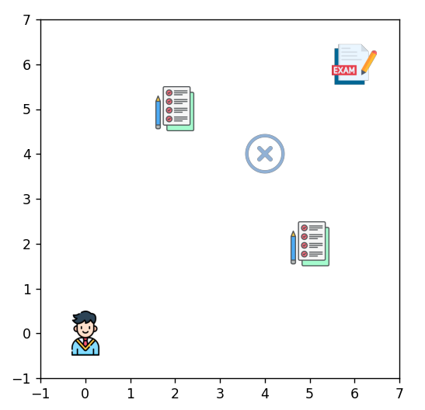
With Power-Ups
Student (Agent)
Exam (Goal)
Assignments (Power-Ups)
De-Registration (Blocker)

Slide 8
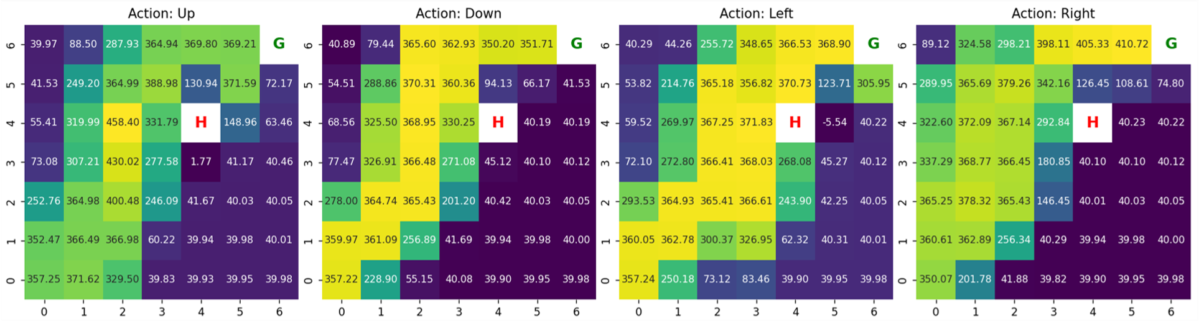
Case With Power-Up

Slide 9
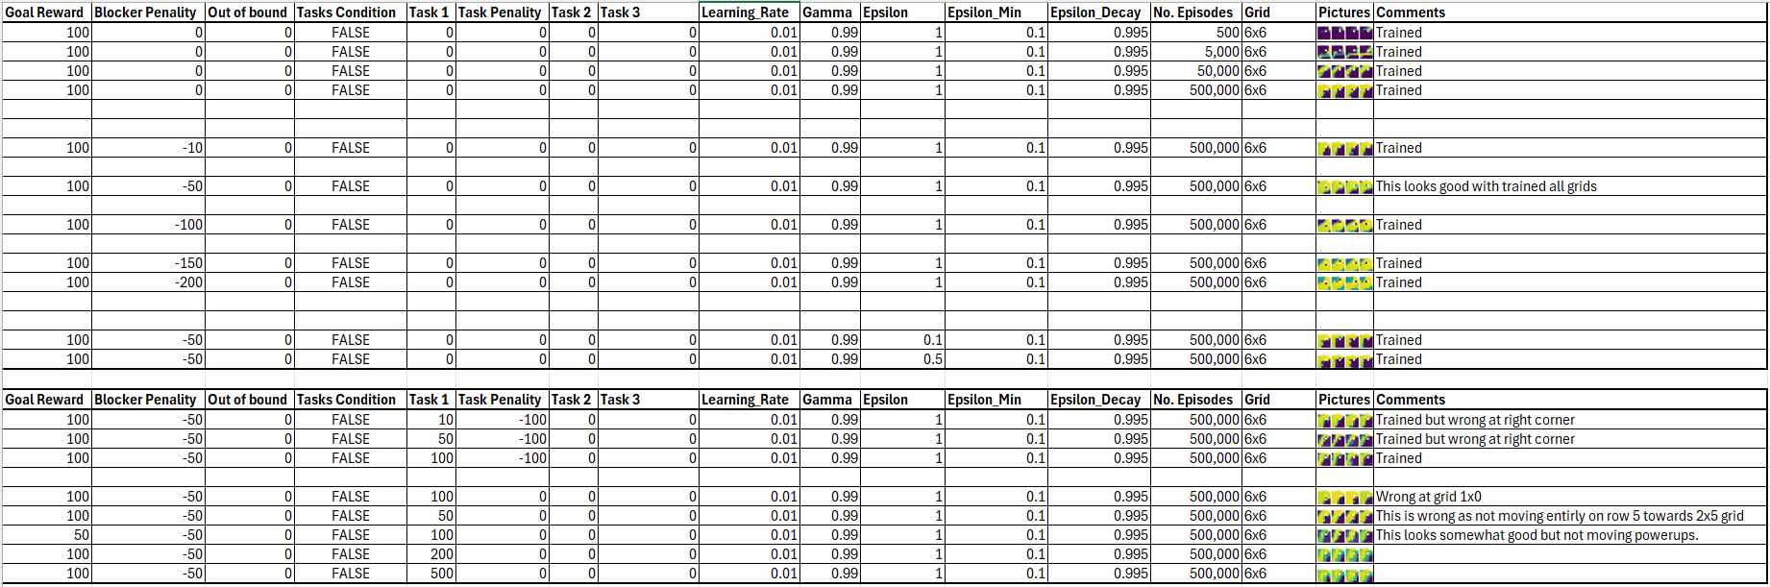
Case Covered

Slide 10
Conclusion:
Problems faced:
Python OOPs coding methodology.
Setting the code of q-learning in my own environment.
More Area can be covered.
Boundary condition like giving negative reward on boundaries.
Having more than one power-ups.
Having negative reward on goal if it doesn’t collect power-ups.
Learned Python.
Learned about autonomy and decision making.
Learned how to build a custom environment.
Learned how to train an agent.

